Slide 1
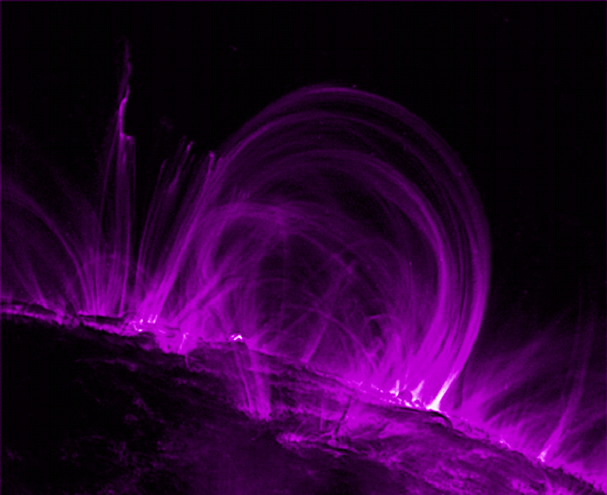
Magnetism and
Domain Theory

Slide 2
Law of Magnetism
The Law of Magnetism states:
Diagram:

Slide 3



What is a Magnet?
A magnet is an object that produces an external
___________ _________.
A magnet applies …
Magnetic fields can also be caused by _________________.
What Materials are Magnetic?

Slide 4
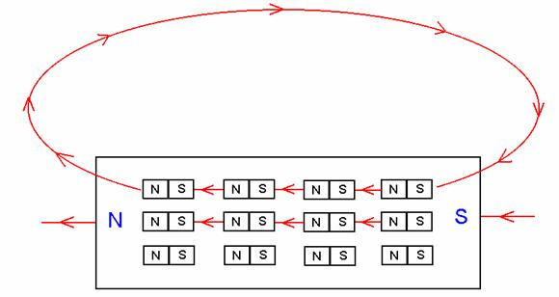
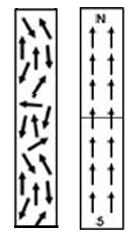
Domain Theory
Ferromagnetic elements like iron, have groups of atoms with their _________________aligned. These regions are called ____________ and each domain is like a mini-bar magnet.
When all the domains are allowed to ________, the whole object takes on a _______________ magnetic field.

Slide 5
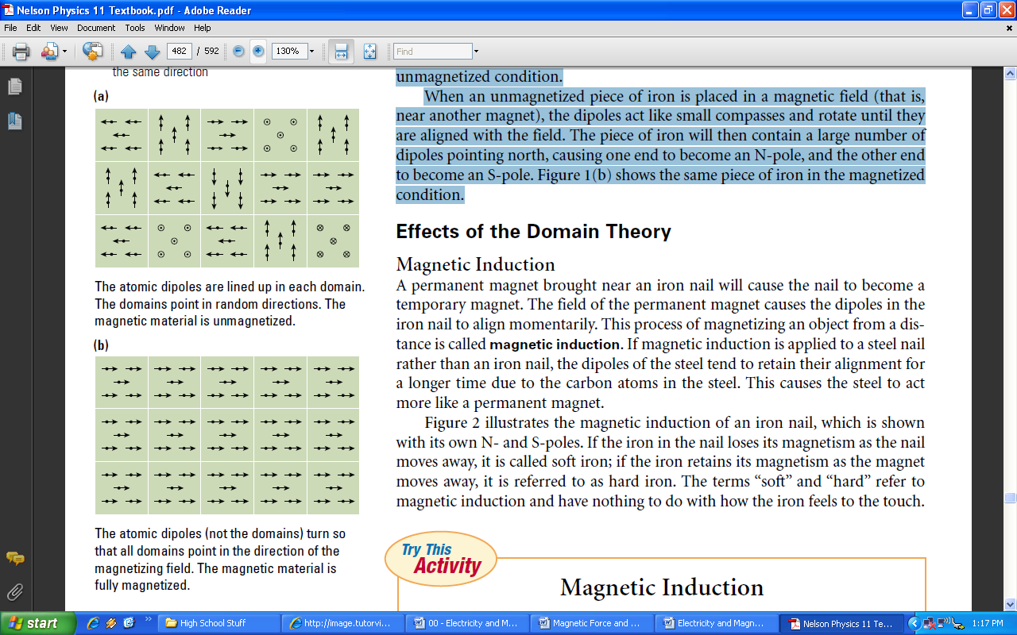
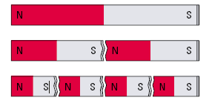
Domain Theory (Continued)

Slide 6
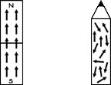
Magnetizing Magnets

Slide 7
Demagnetizing Magnets

Slide 8
Ferromagnetic Materials
What Materials are Magnetic?
List some Other Materials that cannot be magnetized:

